Slide 1
Microservices
And domain-driven design (DDD)
Ralph.squillace@Microsoft.com

Slide 2
The short version
What a microservice architecture is
Why now
What you need to know

Slide 3
My version of 12factor.net:
All stuff in origin/master, or it goes there.
Microservice code and config completely autonomous.
All non-domain resources are autonomous addressable resources.
Building, releasing, and running are autonomous.
Microservice goal: one stateless process.
Caveat: when point of service is to do multiprocess or stateful work (dbs).
If service is hosted in other framework, microservice treats framework as part of microservice as a unit.
Don’t block. Ever.
Throw problems away and start a fresh un-problem.
Test in production.
Logs are live test streams; see previous.
Admin processes: rarely, but against live code. See previous^2.

Slide 4
My version of Martin Fowler: “While there is no precise definition of this architectural style, there are certain common characteristics around organization around business capability, automated deployment, intelligence in the endpoints, and decentralized control of languages and data.” -- http://martinfowler.com/articles/microservices.html
Components are called “services”
Services based on business capabilities or processes, not skills.
Services are never finished, even when shipping.
Simplest communication possible (REST/oauth2); service logic can be complex.
Note: this is NOT the SOA approach!
Destroy implementation code/library standards. Only service façade and behavior matters.
Data just more microservices.
Automate EVERYTHING.
Failure is a normal part of entropy.
Chaos Monkey, the Simian army, and the Circuit Breaker pattern.
Evolutionary design – see point three, above.

Slide 5
Let’s break out the similarities:
Services are focused, entirely self-sustaining, largely single processes.
Everything external to the domain context of the service is a REST call (98% case) to another service for that domain.
Never tell the team how to build the service from the point of view of another service.
Failing services are destroyed and replaced as fast as possible. Period.
At scale, monitoring, logging, and testing are identical.

Slide 6
Thing to grok: Microservices are autonomous single processes
What does this even mean?

Slide 7
Thing to grok: Microservices are autonomous single processes
What does this even mean?
Means everything necessary to do that thing are in the service, and no more.
All the code
All the configuration
Nothing, not one thing, more
Architectural issue:
Java app inside tomcat?
Nginx and mysql?
Nginx and redis/memached?

Slide 8
Cache
SMS API
DB
Web
We could stuff everything into one service...

Slide 9
C4: redis
C2: sms
C3: db
C1: web
We’ll pick functionally atomic units to turn into services.

Slide 10
db (C3)
Read/Cache
Write
redis (C4)
sms (C2)
web (C1)
We need 4 services so that we can scale components independently.

Slide 11
db (C3)
db (C3)
db (C3)
Read/Cache
Write
redis (C4)
sms (C2)
web (C1)
sms (C2)
web (C1)

Slide 12
Things to grok: edit your microservice specification violently
Everything external to the domain context of the service is a REST call (98% case) to another service for that domain.

Slide 13
Digression: Domain-driven design: DDD

Slide 14
Things to grok: Don’t order the code
Never tell the team how to build the service from the point of view of another service. Don’t systematize on libraries or code across services.
C++ is great
Python is lovely
Javascript even better
Haskell – sure, why not
We’re big fans of C#...
YOU. DO. NOT. CARE.
If the inputs, outputs, throughput, and failure rates are met, it’s gold. They get power, and the responsibility that comes with it.
But they’ll need your guidance. ☺

Slide 16
Implications for humans
Ah, execution. Tough stuff.

Slide 17
Implications for humans
Developers think they gain impact; they’re right. They also gain complete responsibility for failure.

Slide 18
Implications for humans
Operations focused on hardware drops massively over the next five years.
Operations focused on developing and managing software compute abstractions increases dramatically.

Slide 19
Implications for humans
Architects focus on everything more and more.
Datacenters are now programs. Programs in datacenters are programs running in programs.

Slide 20
Implications for humans
Because everyone has more focus on apps and infrastructures as apps, that means….
Reorg!!!

Slide 21
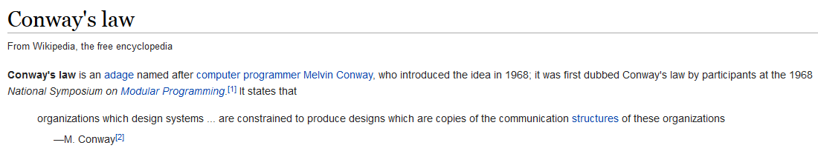
Implications for humans
Use Conway’s law to our advantage
http://en.wikipedia.org/wiki/Conway%27s_law

Slide 22
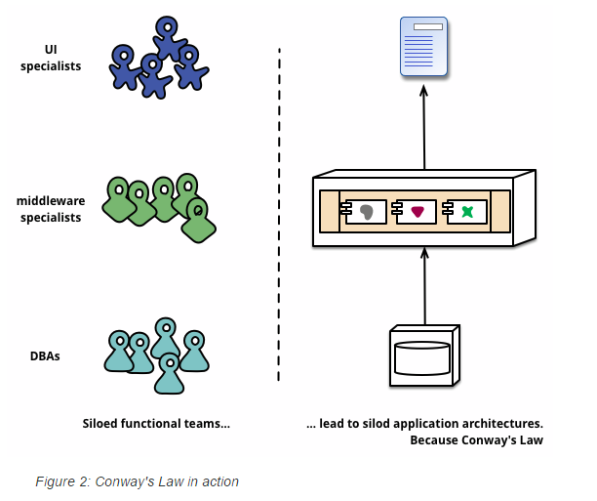
Implications for humans

Slide 23
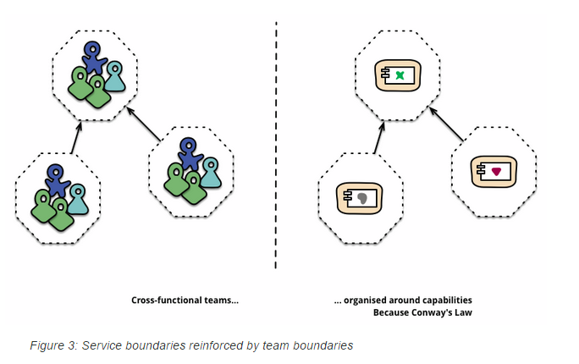
Implications for humans

Slide 24
Thing to grok: Throw it away, NOW.
If the point of a bunch of services is independence and the ability to survive errors, then when there’s an error, collect what you need and throw it away.
NEVER connect to a service to manually debug. What are you thinking?

Slide 25
Thing to grok: any blocking call should be destroyed
Duh. Event driven.

Slide 26
Things to grok: know precisely your microservice’s domain
This is, in essence, the ability to understand what you own and what you do not.
*(and stick to it)
NOT. SIMPLE.
Means you might dabble in….

Slide 27
Things to grok: The app is everything at once
Two levels of architecture:
Microservices themselves
How all the microservices work together

